Slide 1
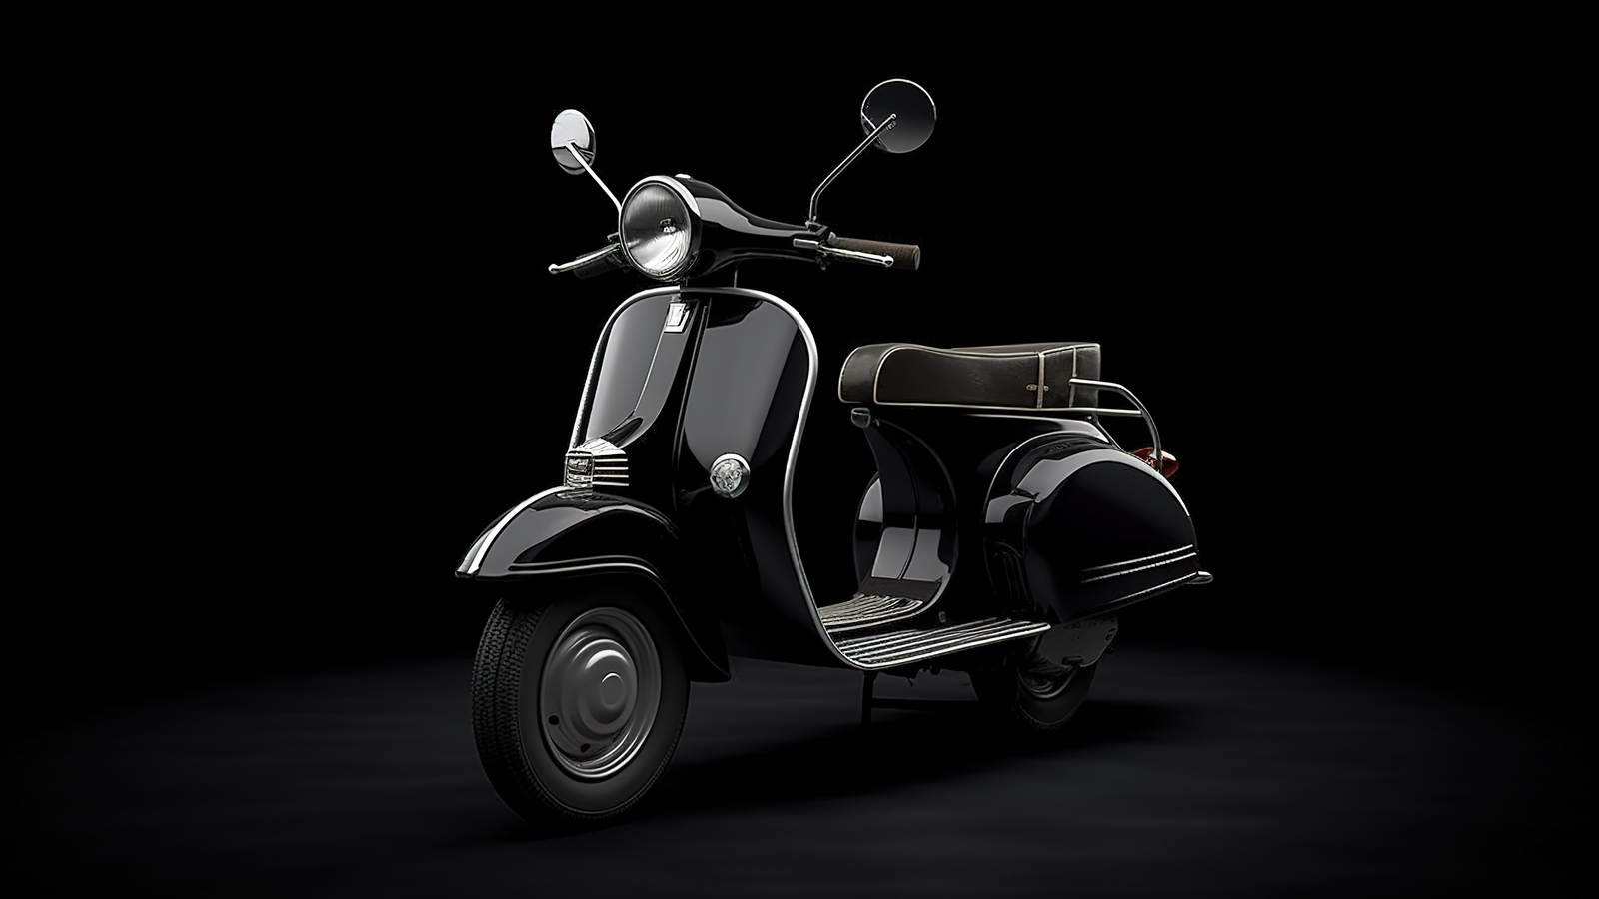

Motor Wassit
Hemza El bouhali
Front-End
2023 – 2024
Notes:
1. INTRODUCTION

Slide 2

MotorWassit
Motorwassit it’s a web site work as intermediary
Between buyer and seller and at motorwassit you can find all type of motorcycle & parts & Blog
Also solution of some motor problem

Slide 3

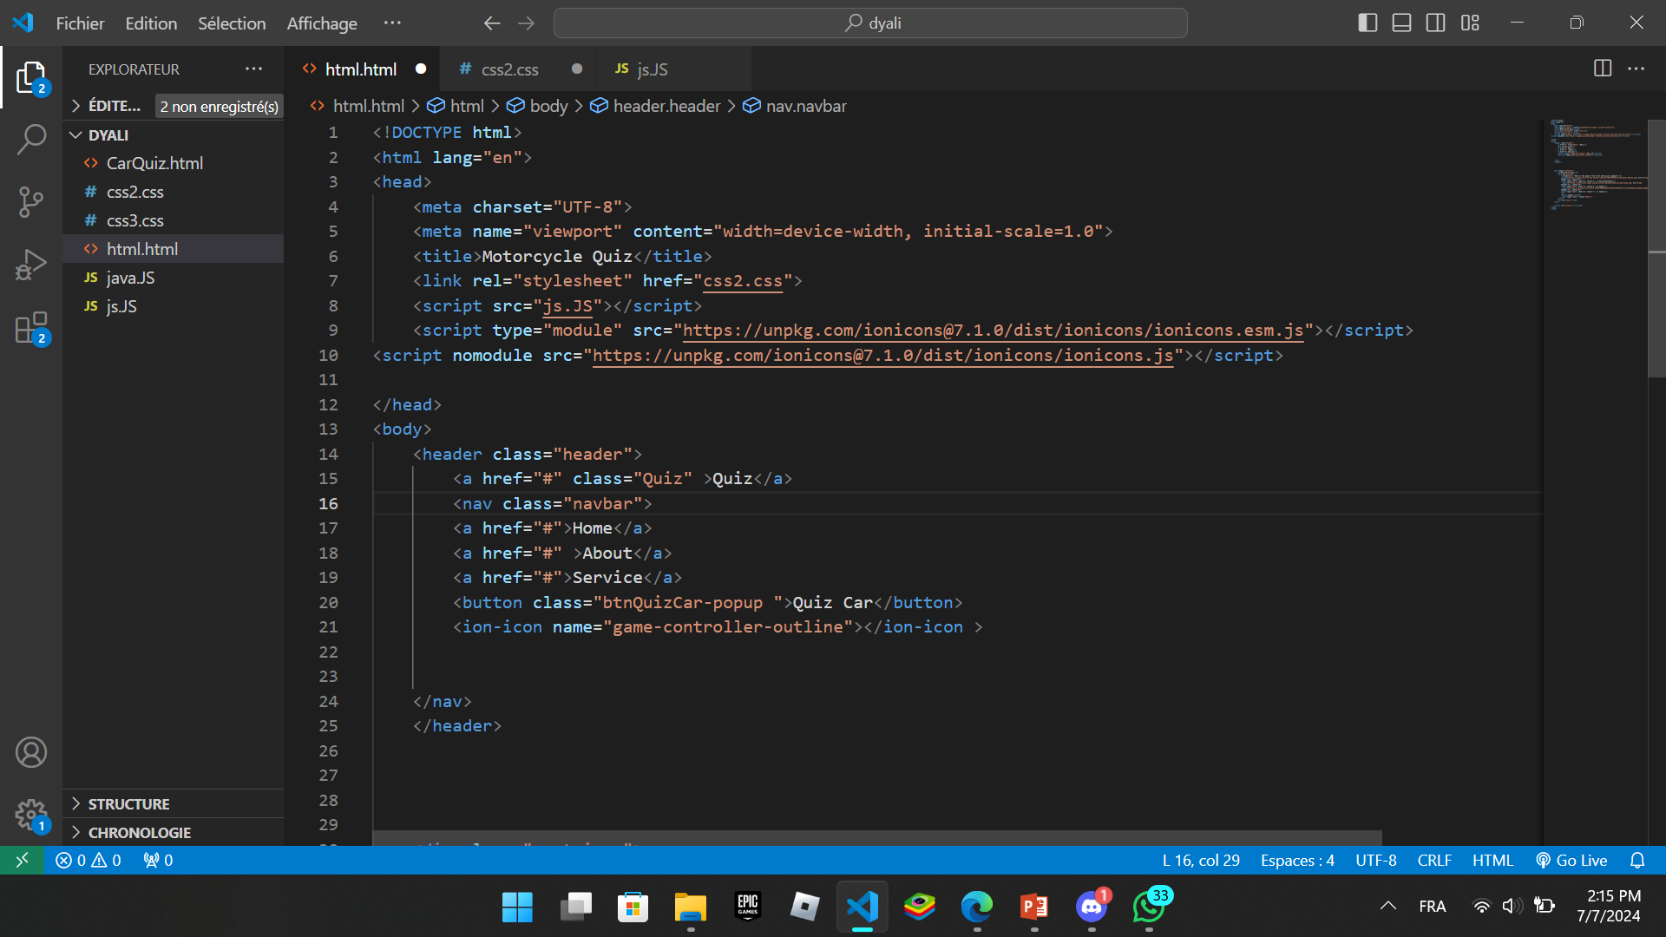
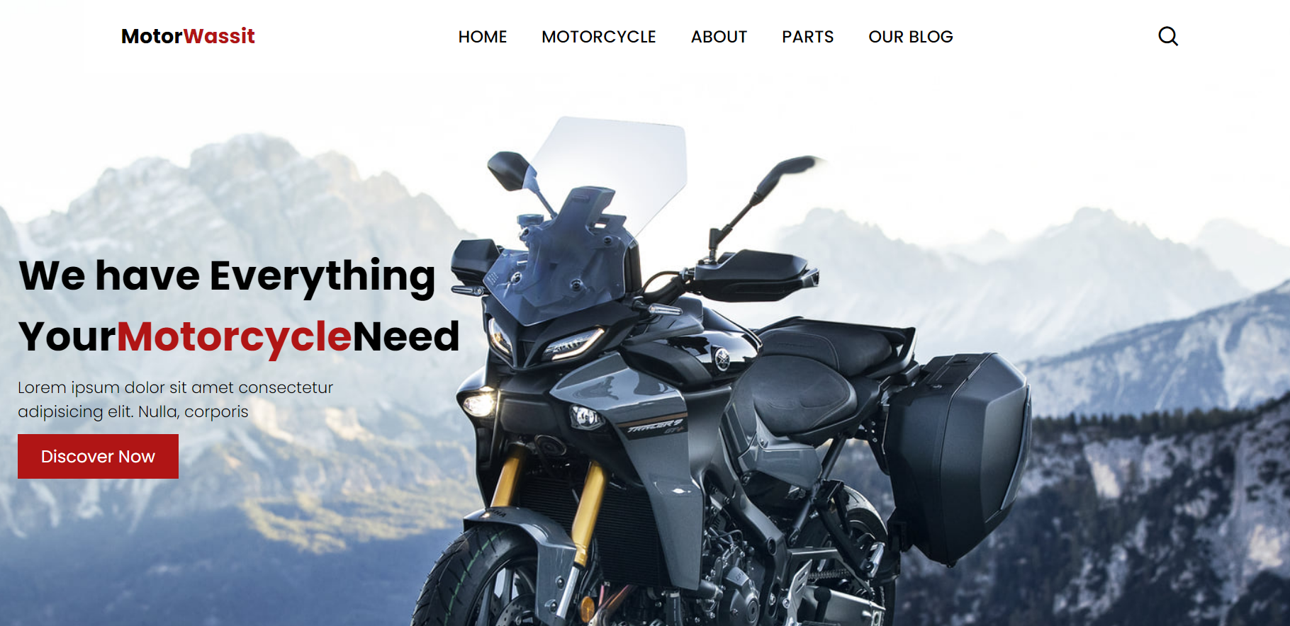


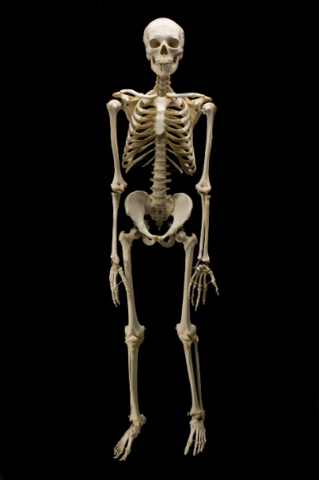
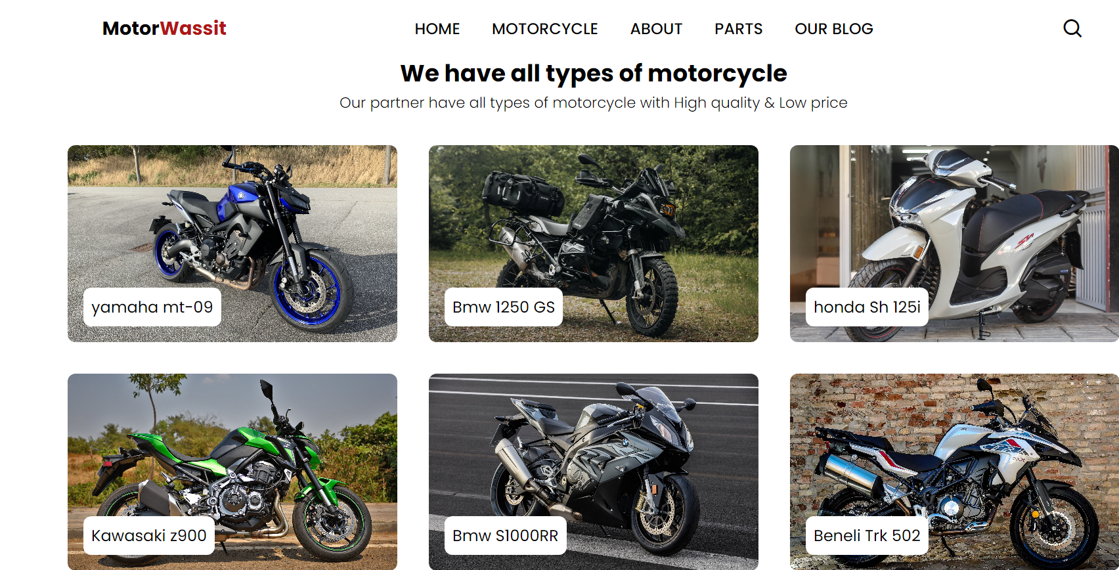




Vs code
<
1- html: Language used to describe the structure of web pages
2-css: while CSS specifies styles such as colors and layouts.
3-java-script (JS): is a programming language used to make web pages interactive

Slide 4

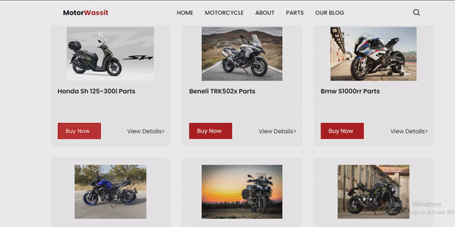
MotorWassit --
<GIF moving image of Project ( if available ) >
<1-sentence value proposition>
IBRAHIM HASSAN

Slide 5



Find your perfect Ride today. Explore MotorWassit For Motorcycle
Also parts and expert
Advice
: Motor_Wassit_Agadir
Motorwassit@gmail.com
+212606615668

